Slide 1
Child Safety Training
<insert your ecclesia> 2020
Notes:
<Insert Ecclesial Name>
Target audience the members of the ecclesia

Slide 2
Jesus said, "Let the little children come to me, and do not hinder them, for the kingdom of heaven belongs to such as these." Matthew 19:14
Notes:
Target audience Recorder/Secretary and Management Committees

Slide 3
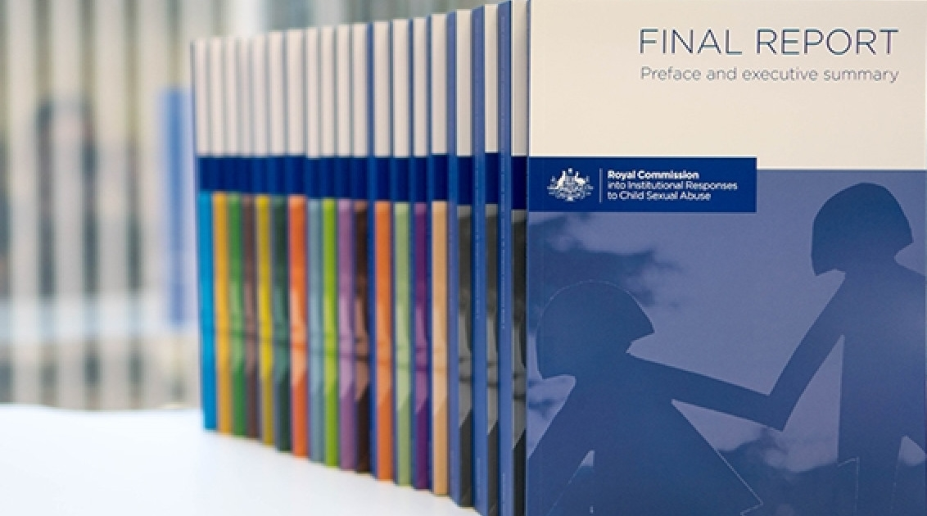
Didn’t we do this last year?
Yes!! Each year our Child safety policy is reviewed.
The Royal Commission into Institutional Responses to Child Sexual Abuse published their final report in 2017 with lots of recommendations for organisations including churches.
Based on these recommendations, the Association of Australian Christadelphian Ecclesias (AACE) published a Child Safety Policy as a template for Child Safety policies in ecclesias (September 2019).
NSW has child safety legislation including working with children checks and The Children’s Guardian Act.
Notes:
A few things have changed since our last update.
Yes we do review our child safety policy each year
Most people will have heard about the Royal Commission - the recommendations fill 91 pages.
The Management Committee have adopted a policy based on the one developed by the AACE.
We also need to develop a code of conduct that is relevant to us.

Slide 4
Notes:
What are the things we are already doing in our ecclesia to keep children safe?

Slide 5
A “child safe” ecclesia
A child safety policy based on the AACE policy.
A code of conduct.
Management Committee to discuss child safety at every meeting.
Working With Children Checks (WWCC) are required for the Management Committee, all involved with the Sunday School but particularly Sunday School Teachers as well as all involved in youth activities and other child-related roles. Everyone else is an optional “opt in”.
Child Safety Officer role who verifies all WWCCs online and keeps the mandatory records.
Annual training / briefing for everyone.
A roster for playground supervision.

Slide 6
Do we have a children’s policy at our ecclesia?
YES!
A copy is available in the ecclesial handbook and on our website.
It is reviewed each year and updated as needed.
our policy

Slide 7
What does the child safety policy cover?
Our responsibilities as an ecclesia and as individuals in our ecclesia.
Information on how to recognise signs of abuse.
Information on how to report an incident or concern about abuse.
Procedure for how any reports will be handled, including confidentiality.
policy
procedures
code of conduct
Notes:
If you have a reasonable suspicion of abuse you should report it … but what is a reasonable suspicion?
Reasonable suspicion means fair and practical reason to believe an incident involving sexual abuse has occurred based on either verbal communication, hearsay, rumour or observance of behaviour.

Slide 8
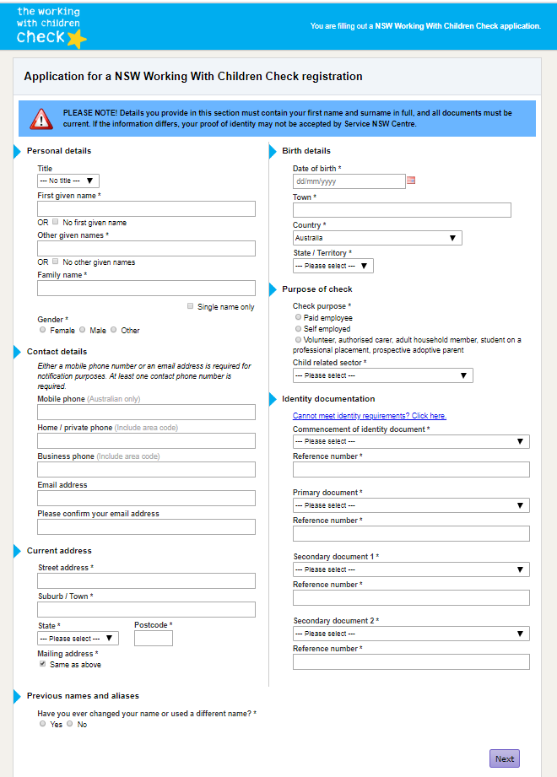
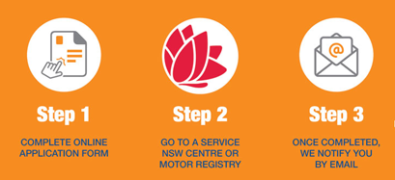
Who must have a WWCC?
Child Protection (Working with Children) Regulation 2013
Part 2 Clause 13 Religious services
Work for a religious organisation where children form part of the congregation or organisation is child-related work, if the work is carried out:
(a) as a minister, priest, rabbi, mufti or other like religious leader or spiritual officer of the organisation, or
(b) in any other role in the organisation involving activities primarily related to children, including youth groups, youth camps, teaching children and child care.
Notes:
The Child Protection (Working with Children) Regulation 2013 is the law in NSW for Working With Children Checks.
It applies to all sorts of organisations that provide services for children including schools, sporting clubs and churches.
Child Protection (Working with Children) Regulation 2013
Current version for 27 May 2019 to date (accessed 19 October 2019 at 14:33) Part 2 Clause 13
Reference: https://www.legislation.nsw.gov.au/#/view/regulation/2013/156/part2/sec13

Slide 9
What does the Child Safety Officer do?
Ensures Working With Children Checks (WWCC) are up to date and everyone who is required to have one by law is up to date and verified.
Alerts the ecclesia to changes to the laws relating to child safety.
Someone you can talk to about any concerns or questions you may have.
Prepares training materials / quiz for the ecclesia to make sure everyone is aware of the policy and procedures.
Who is currently our Child Safety Officer?
Who is responsible for Child Safety in our ecclesia?
?
Notes:
Who is responsible for Child Safety in our ecclesia? EVERYONE has a role to play.

Slide 10
What is reportable conduct?
Reportable conduct is defined as a sexual offence, sexual misconduct, ill treatment, neglect, assault offence under 43B or 316A of the Crimes Act 1900 and behaviour that causes significant emotional or psychological harm to a child.
The Recorder/Secretary is responsible for making reports as the ecclesial “head of entity”; see the NSW reportable Conduct Scheme.
?
Notes:
https://www.kidsguardian.nsw.gov.au/child-safe-organisations/reportable-conduct-scheme

Slide 11
How can you help to make our ecclesia child safe?
Participate in annual training and keep up to date on the child safe policy.
Keep your Working With Children Check and contact details up to date.
Supervise the playground, act as hosts at children / youth activities, consider child safety when planning all ecclesial activities (especially any overnight).
Be alert to any unusual behaviour or signs of concern in our children and young people; listen to their concerns.
Raise issues, concerns or questions with the Child Safety Officer or the Management Committee or report incidents directly.
Time to complete a quiz
Notes:
Quiz - a training activity cunningly disguised as a quiz! Share a link to an online survey quiz ... the results of which can be stored as proof of the training taking place.

